Slide 1

Exploratory analysis of Big Data and Cloud EDABDC
Data Models

Slide 2
Common data models
Hierarchical Data Model
Relational Data Model
Document Data Model
Key-Value Data Model
Graph Data Model
Time series data model
Spacial Data Model
Multi-Model Databases

Slide 3
Time Series Data Model
The time series data model is designed to handle sequences of data points indexed in chronological order.
This model is particularly useful for applications where tracking changes over time is crucial, such as monitoring sensor data, stock prices, weather data, and logs from systems.

Slide 4
Key Concepts of the Time Series Data Model
Time Series:
A time series is a sequence of data points, typically consisting of successive measurements made over a time interval.
Each data point in the series is associated with a timestamp.
Timestamps:
Timestamps are crucial as they indicate when the data point was recorded.
Timestamps can be at different granularity levels, such as seconds, minutes, hours, or even days.

Slide 5
Key Concepts of the Time Series Data Model
Data Points:
A data point is an observation at a particular time.
It typically consists of a timestamp and one or more associated values (e.g., temperature, humidity, price).
Tags/Labels:
Tags or labels are metadata associated with time series data.
They provide additional context or dimensions, such as location, device ID, or metric type, facilitating filtering and querying.

Slide 6
How Data is Structured
Series Key: Each time series can be identified by a unique key, often a combination of tags and metric names.
Ordered Data: Data points are stored in chronological order to optimize time-based queries.
Compression: Time series databases often use compression techniques to efficiently store large volumes of data.
Retention Policies: Time series databases typically support retention policies, automatically deleting old data based on predefined rules.
Aggregation policy: Rules and procedures used to summarize or aggregate detailed time series data into more manageable and useful forms. Aggregation is crucial for reducing the storage requirements of time series data and for enabling efficient querying and analysis

Slide 7
Example
Consider a time series database storing temperature readings from multiple sensors:
Series Key: sensor_id:12345, metric
Data Points:
2024-06-01T00:00:00Z: 25.3°C
2024-06-01T01:00:00Z: 24.8°C
2024-06-01T02:00:00Z: 24.5°C

Slide 8
Use Cases
Monitoring and Observability: System metrics, logs, and traces for monitoring applications and infrastructure.
Financial Data: Stock prices, trading volumes, and other financial metrics.
IoT Data: Sensor readings from IoT devices, including environmental data and smart home metrics.
Scientific Research: Climate data, astronomical observations, and other scientific measurements.

Slide 9
Popular Implementations
InfluxDB: A time series database known for high performance, built-in dashboarding (via Chronograf), and integration with Telegraf for metrics collection.
TimescaleDB: An extension on PostgreSQL designed for time series data, combining SQL querying capabilities with time series optimizations.
Graphite: A monitoring tool that stores time series data and provides real-time visualization.
Prometheus: A monitoring system and time series database commonly used in cloud-native environments.

Slide 10
insert data to influxdb
INSERT temperature,location=office value=22.5
INSERT temperature,location=office value=23.0
INSERT temperature,location=lab value=19.5
INSERT temperature,location=lab value=20.0

Slide 11
Common data models
Hierarchical Data Model
Relational Data Model
Document Data Model
Key-Value Data Model
Graph Data Model
Time series data model
Spacial Data model
Multi-Model Databases

Slide 12
Spacial Data Model
A Spatial Data Model is a conceptual framework used to represent and organize spatial data, which refers to data that has a geographic or geometric component. Spatial data models are essential in Geographic Information Systems (GIS), computer-aided design (CAD), and other applications where the location, shape, and relationships of objects in space are important.

Slide 13
Key Concepts in Spatial Data Models
Spatial Data:
Spatial data describes the location, shape, and relationships of objects in space. It can represent points (e.g., cities), lines (e.g., roads), or polygons (e.g., land parcels).
Spatial Relationships:
These describe how spatial objects relate to one another, such as proximity (nearness), containment (one object inside another), or adjacency (objects sharing a boundary).
Coordinate Systems:
Spatial data is often represented using coordinate systems (e.g., latitude/longitude or Cartesian coordinates) to define the position of objects in space.

Slide 14
Types of Spatial Data Models:
Vector Data Model
Raster Data Model

Slide 15
Vector Data Model
Represents spatial data using points, lines, and polygons.
Each feature is represented as a geometric shape with coordinates.
Components:
Points: Represent discrete locations (e.g., a city or a landmark).
Lines: Represent linear features (e.g., roads, rivers).
Polygons: Represent areas (e.g., land parcels, lakes).
Advantages:
Precise representation of features.
Efficient for storing discrete boundaries.
Use Cases: Urban planning, transportation networks, and land management.

Slide 16
Raster Data Model
Represents spatial data as a grid of cells or pixels, where each cell has a value representing a feature (e.g., elevation, temperature, or land cover).
Components:
Cells/Pixels: The smallest unit of the grid, each with a value.
Resolution: The size of each cell determines the level of detail.
Advantages:
Suitable for continuous data (e.g., elevation, satellite imagery).
Efficient for analyzing large areas.
Use Cases: Environmental modeling, weather forecasting, and remote sensing.

Slide 17
Spatial Data Model Components
Entities: Real-world objects (e.g., buildings, rivers).
Attributes: Descriptive information about the entities (e.g., name, area, population).
Topology: The study of spatial relationships (e.g., connectivity, adjacency, containment).
Coordinate Systems: Frameworks for defining locations (e.g., WGS84 for latitude/longitude).

Slide 18
Applications of Spatial Data Models
Urban Planning: Designing cities and infrastructure.
Environmental Science: Monitoring ecosystems and natural resources.
Transportation: Optimizing routes and managing traffic.
Disaster Management: Mapping flood zones or earthquake-prone areas.
Navigation Systems: GPS and location-based services.

Slide 19
Recap
In summary, a spatial data model provides the structure and rules for organizing and analyzing spatial data, enabling us to understand and visualize the physical world in a digital format.

Slide 20
Common data models
Hierarchical Data Model
Relational Data Model
Document Data Model
Key-Value Data Model
Graph Data Model
Time series data model
Spacial Data Model
Multi-Model Databases

Slide 21
Multi-model databases
Multi-model databases are a type of database management system (DBMS) designed to support multiple data models under a single integrated backend.
This allows users to store, manage, and query data in various formats using different paradigms within the same database system.

Slide 22
Key Features
Multiple Data Models: Multi-model databases support different types of data models such as:
Relational: Traditional table-based format used for structured data.
Document: JSON, BSON, or XML format used for semi-structured data.
Graph: Nodes and edges used for data with complex relationships.
Key-Value: Simple key-value pairs used for high-performance data retrieval.
Column-Family: Similar to relational but optimized for wide-column storage.
Object: Data stored as objects, similar to object-oriented programming.

Slide 23
Key Features
Unified Query Interface: Users can query data across different models using a single query language or a combination of query languages. SQL, for example, can be extended to support querying graph or JSON data.
Consistency and Transactions: Multi-model databases often support ACID (Atomicity, Consistency, Isolation, Durability) transactions across different data models to ensure data integrity.
Flexibility and Scalability: They provide flexibility in data modeling and are scalable to handle large volumes of diverse data.

Slide 24
Advantages
Consolidation: A single multi-model database can replace multiple specialized databases, simplifying the architecture and reducing maintenance overhead.
Cost Efficiency: Reduces the need for different DBMS licenses and the resources required to manage them.
Development Speed: Developers can choose the appropriate data model for each use case without needing to integrate and maintain multiple systems.
Operational Efficiency: Unified management and monitoring tools streamline operations and improve efficiency.

Slide 25
Use Cases
Enterprise Applications: Applications requiring diverse data types, such as e-commerce platforms, benefit from the flexibility of multi-model databases.
Content Management Systems: Handling varied content types (text, metadata, relationships) efficiently.
IoT Applications: Storing and processing a mix of time-series data, metadata, and device relationships.
Social Networks: Managing complex relationships and unstructured content.

Slide 26
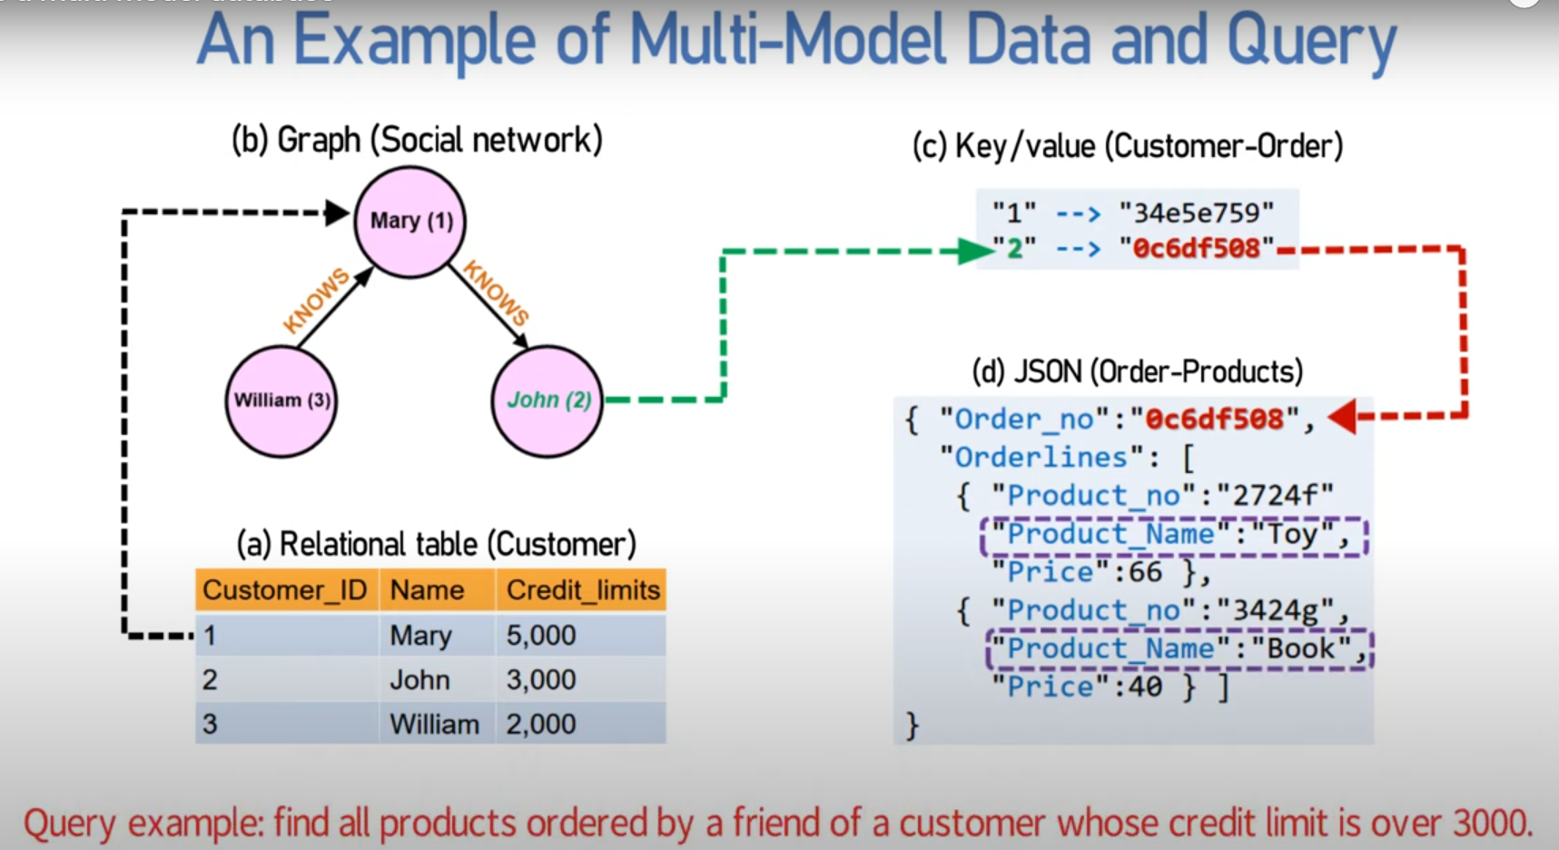

Slide 27
Examples of Multi-Model Databases
Oracle Database: Supports relational, JSON, XML, and spatial data.
ArangoDB: A native multi-model database supporting graph, document, and key-value models.
Couchbase: Supports key-value, document (JSON), and SQL++ for querying.
MarkLogic: Designed for handling XML, JSON, RDF, and other data models.
OrientDB: Supports graph, document, object, and key-value models.

Slide 28
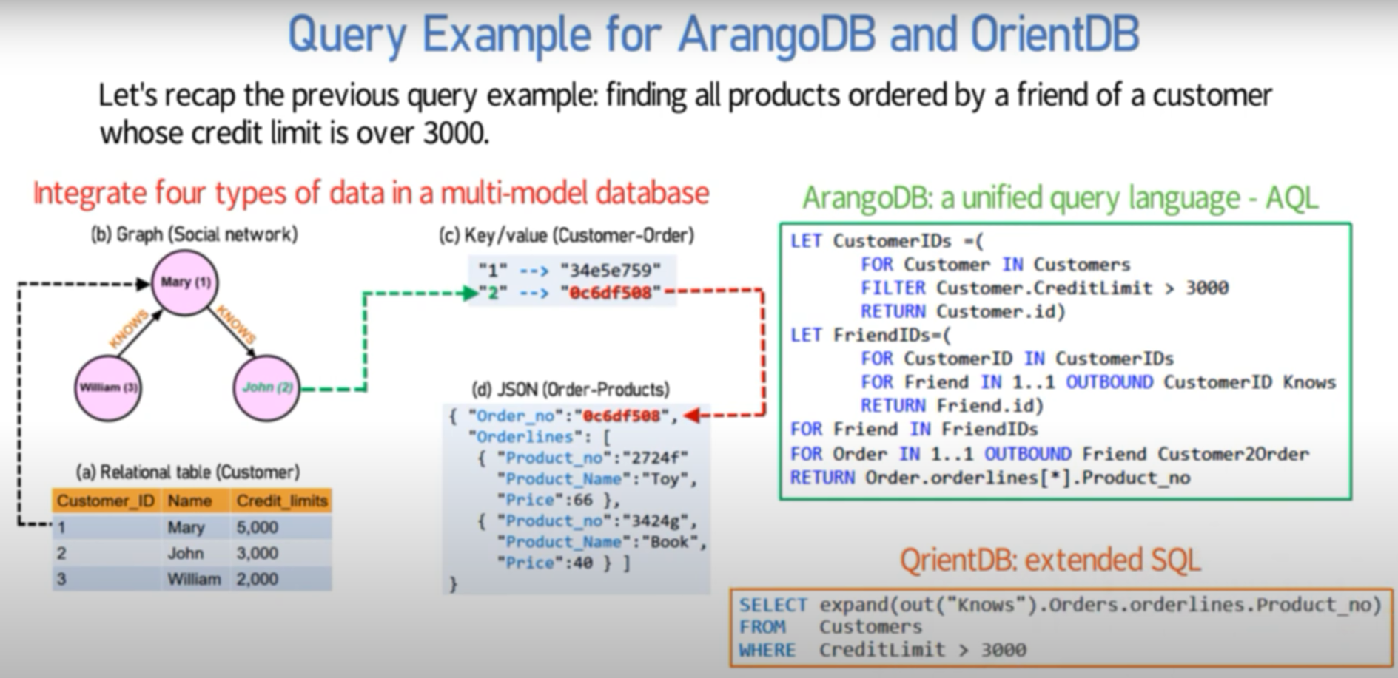

Slide 29
Some Multi-Model Databases and supported data models
Database | Supported Data Models
Oracle Database | Relational, JSON, XML, Spatial
ArangoDB | Graph, Document, Key-Value
Couchbase | Key-Value, Document (JSON), SQL++
MarkLogic | XML, JSON, RDF, Other Data Models
OrientDB | Graph, Document, Object, Key-Value

Slide 30
Examples of Multi-Model Databases
Azure Cosmos DB
Overview: Azure Cosmos DB is a globally distributed, multi-model database service.
Supported Models: It supports multiple data models, including document, key-value, graph, and column-family.
Amazon DynamoDB
Overview: Amazon DynamoDB is a key-value and document database that delivers single-digit millisecond performance at any scale.
Supported Models: Primarily supports key-value and document data models.

Slide 31
Azure and AWS Multi-Model Databases and supported data models
Service Name | Supported Data Models | Supported Data Models | Use Cases
Azure | Azure Cosmos DB | Document, Key-Value, Graph, Column-Family | E-commerce platforms, real-time analytics, IoT applications, global-scale web apps
AWS | Amazon DynamoDB | Key-Value, Document | High-traffic web applications, gaming, ad tech, mobile backends, serverless applications

Slide 32
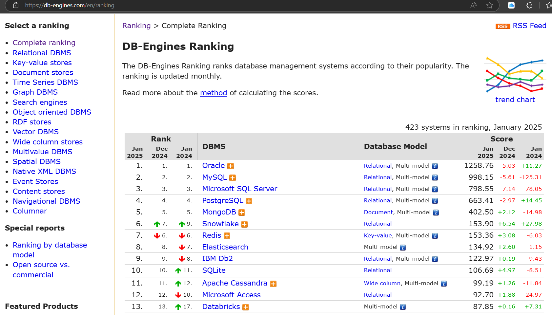

Slide 33
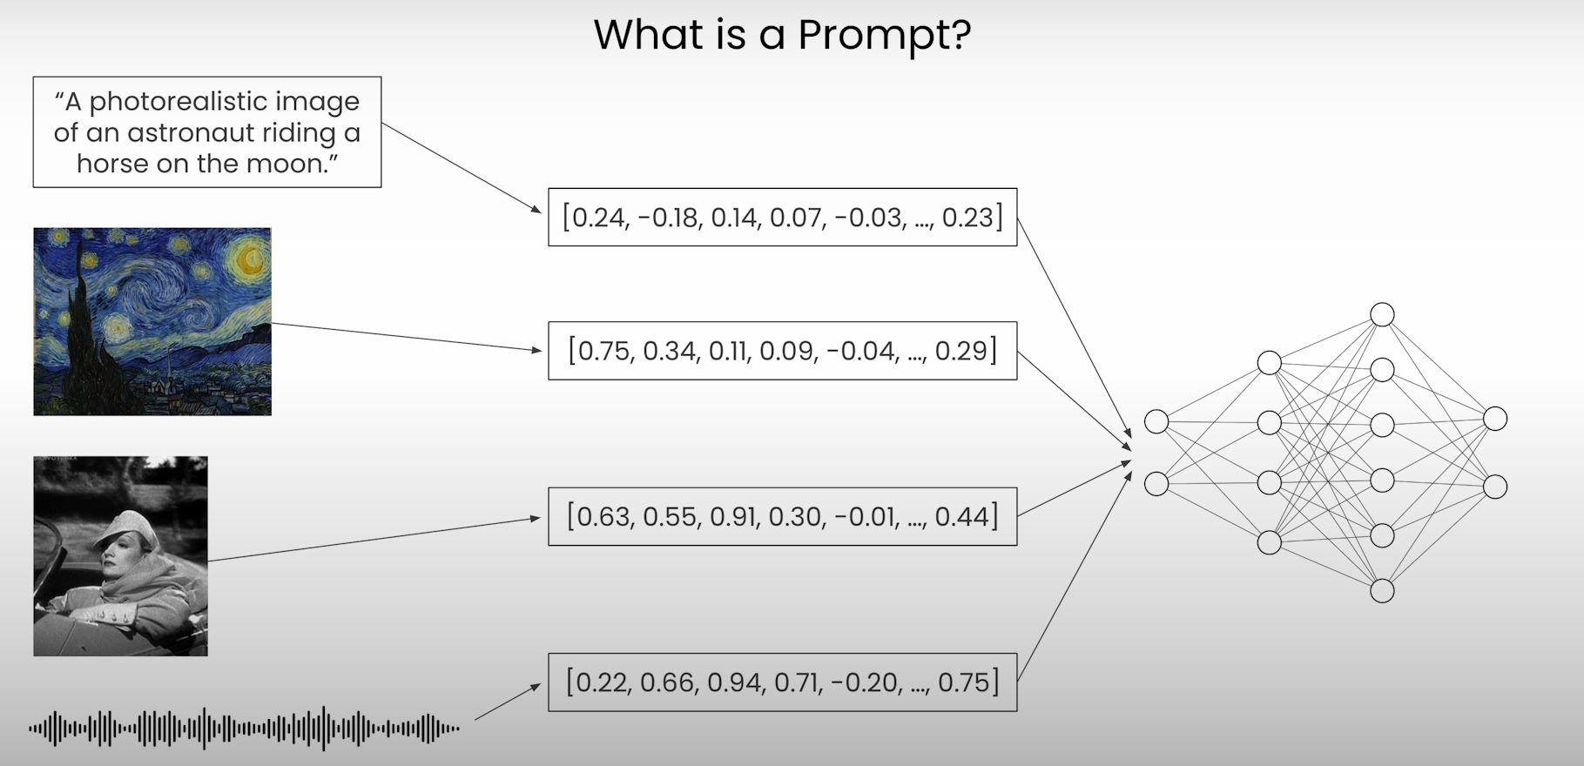
Vector Data store

Slide 34
Data Lakes and Data warehouses
A data lake is a centralized repository that allows you to store all your structured, semi-structured, and unstructured data at any scale. Data is stored in its raw format until it is needed.
A data warehouse is a centralized repository that stores structured data from multiple sources. It is designed for query and analysis, supporting business intelligence and reporting.

Slide 35
Data Lakes and Data warehouses
Aspect | Data Lake | Data Warehouse
Data Types | Structured, semi-structured, unstructured | Structured
Schema | Schema on read | Schema on write
Purpose | Big data processing, machine learning, raw data analysis | Business intelligence, reporting, structured data analysis
Processing Frameworks | Distributed processing frameworks (e.g., Hadoop, Spark) | SQL-based querying and optimized for read performance
Storage Solutions | Inexpensive object storage (e.g., Amazon S3) | Structured storage with optimized indexing and querying capabilities

Slide 36
Common data models
Data Model | Structure | Relationships | Use Cases | Tools
Hierarchical Data Model | Tree-like structure | Parent-child | Organizational charts, file systems | XML in vs code
Relational Data Model Entity-Relationship Model | Tables (relations) Entities and relationships | Foreign keys and primary keys One-to-one, one-to-many, many-to-many | Financial systems, inventory management Database design | SQLite Browser, MS SQL Server, MySQL, PostgreSQL, BigER vs code plugin
Document Data Model (NoSQL database) | Documents (JSON, XML) | Embedded relationships | Content management systems, web applications | MongoDB, CouchDB
Key-Value Data Model | Key-value pairs | Simple lookup | Session storage, user profiles | Redis, AWS DynamoDB

Slide 37
Common data models (Cont.)
Data Model | Structure | Relationships | Use Cases | Tools
Graph Data Model | Nodes and edges | Explicitly stored edges | Social networks, recommendation engines | Neo4j, OrientDB
Time series data model | key series |  | stock data, climate data, IoT, .... | datastax
Multi-Model Databases | Supports multiple data models | Various types | Flexible data handling, diverse use cases | ArangoDB, Couchbase

Slide 38
Recap
Multi-model databases provide a versatile and efficient solution for modern applications that require handling diverse data types.
By integrating multiple data models into a single system, they offer significant benefits in terms of consolidation, cost efficiency, and operational simplicity.
However, they also present challenges that need to be managed, particularly in terms of complexity and performance optimization

Slide 39
Recap
Data: Data refers to raw facts, figures, or information that can be collected, stored, and processed. It can exist in various forms, such as numbers, text, images, audio, or video. Data by itself lacks context or meaning but becomes meaningful when interpreted or organized to provide insights or support decision-making.
Data Model: A data model is a conceptual framework or structure that defines how data is organized, stored, and accessed within a database. It provides a blueprint for representing data entities, their attributes, and the relationships between them. Common types of data models include:
Conceptual Data Model: High-level representation of data requirements.
Logical Data Model: Detailed representation of data structures, independent of the database system.
Physical Data Model: Specific implementation of the data model in a database system.
Database Management System (DBMS): A Database Management System (DBMS) is software that enables the creation, management, and manipulation of databases. It provides tools for storing, retrieving, updating, and securing data efficiently. A DBMS acts as an interface between the database and users or applications, ensuring data integrity, consistency, and security. Examples of DBMS include MySQL, Oracle, PostgreSQL, and MongoDB.

Slide 40

Questions

